Slide 1
Capstone Project - The Battle of Neighborhoods

Slide 2
Introduction/Business Problem
Due to increasing popularity of drinking bubble tea (a new variety of tea) globally, an investor came to me with an idea of opening a bubble tea shop. Bubble Tea is a Taiwanese tea-based drink invented in Tainan and Taichung in the 1980s. Recipes contain tea of some kind, flavors or milk, as well as sugar. Toppings, such as chewy tapioca balls, popping boba, fruit jelly, grass jelly, agar jelly, and puddings are often added.
Investor's main concern is to get a recommendation of the most suitable location to open bubble tea shop in New York. Furthermore, rental price of the shop is not the main concern of the investors. Hence, we should consider a number of factors that could potentially affect how the business would go and also we have to the right neighborhood. With the help from the tools of data science, we can analyze the neighborhoods and decide the best spot to start the business.

Slide 3
Factors affecting the business
Restaurants nearby
Most people would like to get a cup of bubble tea after they have their lunch or dinner. So it is best to set up the bubble tea shop near restaurants. Foursquare are able to provide us with the data of each neighborhood with the information on their top restaurants and even photos and comments.
Cuisine Type
People from different neighborhoods may have very different tastes in food which in turns affects the likelihood of them buying bubble tea after having a good meal. Hence, Cuisine type also an important factor to consider. Customers who enjoy a specific type of cuisine might also share some common interests and characteristics and these characteristics can be analyzed using the data science tools we have learned.
Demographic of the Neighborhoods and Facilities Nearby
Demographical data affects how well the restaurant runs. It is best to set up bubble tea shop in the area with the Most Frequent venues. For example, in an area near restaurants that have high popularity, near cinemas/theaters or even park and gym where people might want to get some drinks after undergoing training or exercises.

Slide 4
Data Preparation
For this project, I will only be analyzing neighborhood in Manhattan due to large amount of restaurants, cinemas and large diversity in population. I will also be using the information of these neighborhoods from Foursquare, especially the ratings and rankings for restaurants in different neighborhoods to get knowledge of the preferences of customers in each neighborhood. Their preferences will then help us decide the best location to set up the business.
For New York City's Boroughs, Neighborhoods and their coordinate values, we use the below JSON file.
https://cocl.us/new_york_dataset
From the above JSON file, we extract only the Bronx Borough’s Neighborhoods.

Slide 5
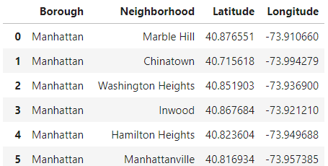
Methodology
First, I loaded the geographical data of neighborhoods in all NYC Next, I filter out the Manhattan from the dataframe whole dataset. A snapshot of the dataset looks like this

Slide 6
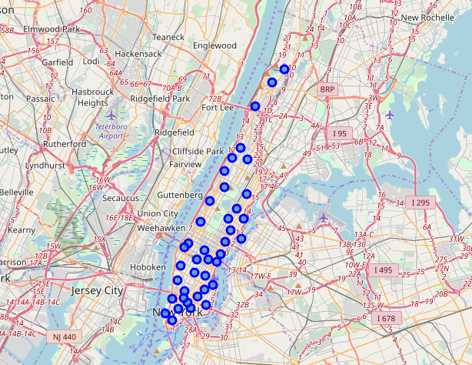
For visualization, we plotted these neighborhoods on the map of Manhattan

Slide 7
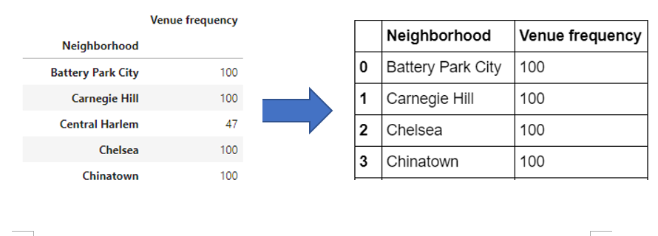
With the help of Foursquare API, we are able to explore the neighborhoods and segment them. Having retrieved restaurants’ data for each of the neighborhood from FourSquare, we then check how many venues were returned for each neighborhood. To make our analysis easier, we will remove neighborhood with number of Venue Category less than the maximum count which is 100. This is because we are concern with the neighborhood which have quite a lot of activities. For instance, more activities near the neighbourhood (i.e gym training, watching movies in theatre, etc) might result in more people coming to get drinks.

Slide 8
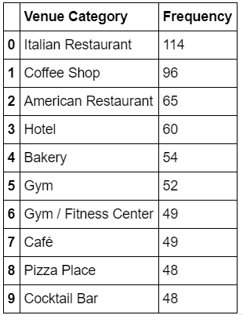
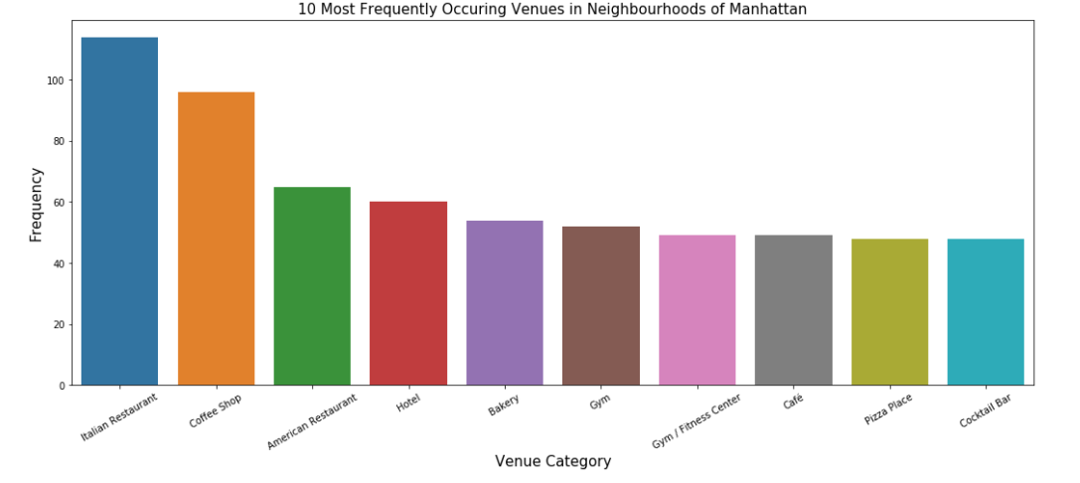
We then create a table that shows the 10 Most Frequently Occuring Venue_Category and also plotted a histogram for better visualization.

Slide 9
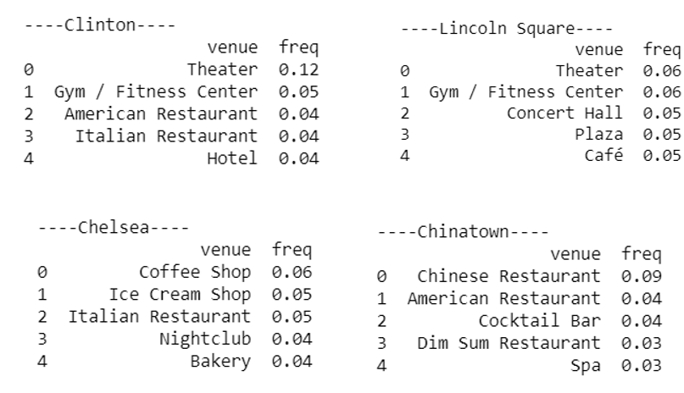
Here we have found out that Italian restaurants top the charts of most common venues in the 5 districts, followed by coffee shop, American Restaurant and Hotel. The Next step was to create the new dataframe and display the top 10 venues for each neighbourhood. A snippet of the dataframe is shown below:

Slide 10
From the above dataframe, we can conjecture that Clinton, Lincoln Square and Chinatown might be a good location to set up the business. This is because most of the activities such as theatre, gym, hotels and restaurants have some correlation with drinking bubble tea. For example, people might tend to buy some drinks after undergoing exhaustive training and exercise or tourist might want to try out the special drinks after they have their lunch or dinner near the restaurant. However, Chelsea might not be a good spot for the business since we will be facing many competitions from coffee shop and ice cream shop. Both coffee and ice cream do not go well with bubble tea.

Slide 11
Results
Finally, we try to cluster the neighbourhoods into 5 clusters based on the frequency of venue categories and by K-Means clustering. So, our expectation would be based on the similarities of venue categories, these districts will be clustered. Using K-Means algorithm rom Scikit-learn library we obtain 3 clusters as shown below.
To visualize the clusters, we plotted the following map. The different colours of the big dot represent different clusters

Slide 12
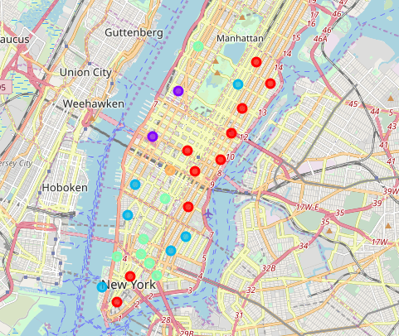

Slide 13
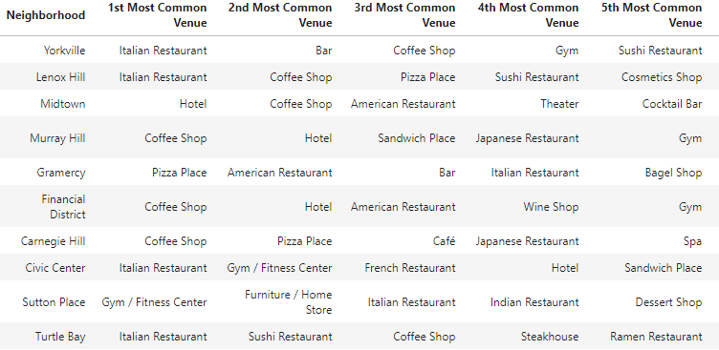
The table below shows the different neighbourhood in different clusters and also the most common venue.
Cluster 1

Slide 14
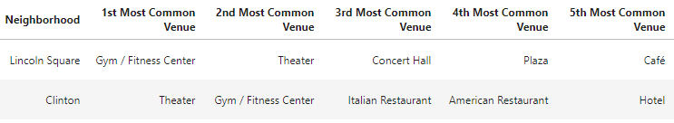
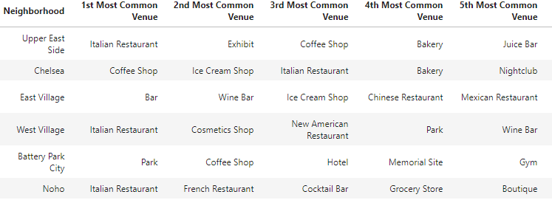
Cluster 2
Cluster 3

Slide 15
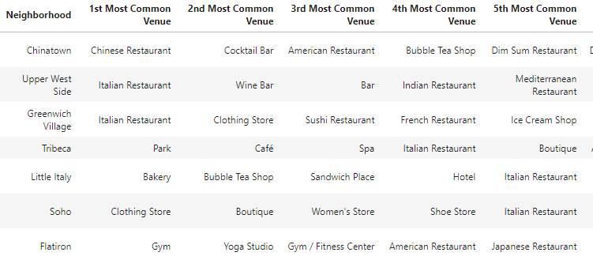

Cluster 4
Cluster 5

Slide 16
Discussion
From the table above, we can clearly see that our conjecture where that Lincoln Square and Clinton might be the good place to start our bubble tea business is right. They are being clustered into the same group 2 since both the location have common venues that are similar and the venues have some correlation with drinking bubble tea.
On the other hand, cluster 3 might not be an ideal location for our bubble tea business as there are quit a lot of venue which might have very low correlation with drinking bubble tea i.e bar, coffee shop, ice cream shop, nightclub etc. This also suggest that our conjecture about Chelsea not being a good location for the business was right.
Cluster 1 and 4 can be considered to be an acceptable location but is still inferior compared to cluster 2 since we will be facing quite a lot of competition (drinks related) from coffee shop, bar and café .
Cluster 5 can also be considered another good spot for our business targeted to Asians or those with high interest in Asian food due to the presence of Korean and Japanese restaurants. Together with the presence of hotels, we can also assume that most of the tourists are Asians. So, we can make a delicious bubble with taste catered for Asians or people which favours Asians cuisines in this location.

Slide 17
Conclusions
With the help of machine learning techniques i.e K-mean Clustering, we were able to merge different neighborhoods into clusters based on their similarities. This also provided insights for the problem we tried to solve in the beginning, that is to suggest a best place to the investor for setting up bubble tea business. By analyzing the clusters, we were able to identify neighbourhood 2 and 5 are the best location for the stakeholder’s business.

